Slide 1
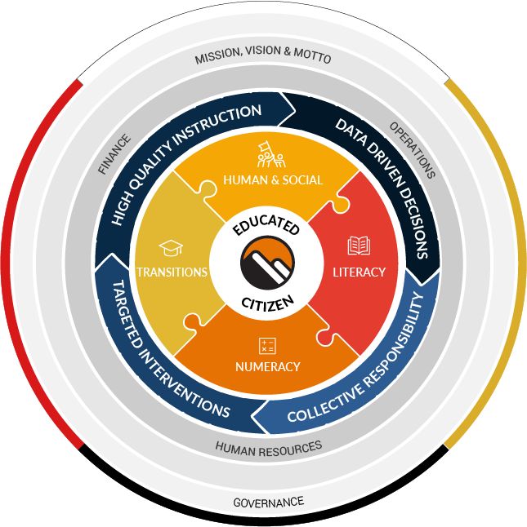
Strategic Plan 2021-2025
Our conceptual framework is designed to communicate the big ideas that we believe about our school district in a visual, holistic fashion.
Features of the framework include:
The framework is wrapped in First Peoples Principles of Learning (FPPL), using the colours of the cardinal directions of the medicine wheel: White, Yellow, Red and Black. The layers of ‘Mission, Vision and Motto’ as well as Governance are positioned at the outer edges of the framework, representing the important role of keeping our organization moving in the same direction as outlined by our Vision:
~Syós:ys lets’e th’ále, lets’emó:t~
(See EYE yees, LETS – a - thala, LETS – a - mot)
~One heart, one mind, working together for a common purpose.~
A Statement About Learning
Learning must be engaging, relevant and meaningful, grounded in inclusive practices and First Peoples Principles of Learning, and committed to the growth of future-oriented citizens.
Insert School Name Here
HIGH QUALITY INSTRUCTION
DATA DRIVEN DECISIONS
Innovative, inclusive and research based instruction and assessment practices support the well-being of all learners and their readiness to be inspired and engaged in life-long learning.
The intentional collection and analysis of meaningful evidence ensures that actions and decisions directly support the success of all learners.
TARGETED INTERVENTIONS
COLLECTIVE RESPONSIBILITY
Timely and targeted supports are the cornerstone in creating a culture of equity and belonging where all learners thrive and reach their potential.
Common core values and shared responsibility for student success promotes deep collaboration and commitment to growth as educated citizens.

Slide 2
LITERACY
GOALS
We are dedicated to ensuring that students are proficient in foundational literacy skills and increase their abilities, confidence and willingness to engage with language to acquire, construct and communicate in meaningful ways from Early Learning Years (pre-K) through to Grade 5
We understand, plan and deliver instruction using competency-based curriculum (curricular competencies and content).
We utilize competency-based assessments to assess student progress pre-K to grade 5.
We implement data driven, timely and targeted instructional interventions for students.
School Actions
School Measures
To have students enjoy writing and feel confident as authors
To build writing stamina
To build common language in Writing by revisiting Yarrow’s Scope and Sequence
To use the ACT to enhance student engagement and understanding of reading.
To implement One Book One School as a common reading experience
To continue to build classroom libraries and have entry points for all readers; to ensure that “just right texts” are accessible for all students
To continue with Early Intervention groups
To continue to build on “Question Techniques” to engage all learners
Tracking learners over time
Using District Assessments
Observations of individuals and small groups
District Measures
FSA 4 (Reading / Writing)
FSA 7 (Reading / Writing)
Literacy 10 and 12
PM Benchmarks (running records)
ACT (Assessment of Comprehension and Thinking)

Slide 3
NUMERACY
Goal
We are dedicated to ensuring that all students become proficient in numeracy skills that allow them to create, apply and conceptualize mathematics in real world situations from Early Learning Years (pre-K) through to Grade 5.
We understand, plan and deliver instruction using competency-based curriculum (curricular competencies and content).
We utilize competency-based assessments to assess student progress pre-K to Grade 5.
We implement data driven, timely and targeted instructional interventions for students.
School Actions
School Measures
To continue to embed Fluency, Mental Math and Connections to student learning
To use SNAP as an effective assessment tool
To connect math to literature and the real world
To use technology to complement math lessons
To represent numbers in different ways, using manipulatives, games, songs and calendar.
To continue using high yield routines; such as, Number of the Day, Number talks and Counting Collections.
To balance hands on learning and paper/pencil work
To continue to practice questions that provoke student engagement
District Assessments
Daily Observations
Formative and Summative
District Measures
FSA 4
FSA 7
Numeracy 10
SNAP (Student Numeracy Assessment and Practice)

Slide 4
HUMAN AND SOCIAL DEVELOPMENT
Goal
We celebrate diversity, embrace inclusion and foster a sense of belonging to ensure all students thrive. Equity and inclusion are foundational to learning and leading, and are critical to success, wellbeing and fulfillment.
We understand, plan and deliver competency-based curriculum (curricular competencies and content) related to Social Emotional Learning and Mental Health Literacy.
We commit to truth, reconciliation and healing to address the inequity of outcomes for Indigenous learners. We address unconscious bias, systemic discrimination and marginalization to transform district culture.
We provide supports for the well-being of all learners.
School Actions
School Measures
To continue to create opportunities for school wide projects that tie directly to the Core Competencies
To make strong connections to Positive Behavior System, using the Six Cedars as a starting point
To utilize district staff to enhance teaching practices
To continue to create opportunities to make learning fun and engaging through culture and school wide events.
To use the Story and Art studios to provide opportunities that elicit a starting point for all learners.
To use school wide language such as the Zones of Regulation to regulate the community.
To continue to use the local environment and community for place-based learning opportunities
To explore connections with local Indigenous people and invite them to share their knowledge
Attendance
Achievement scores
District assessments
District Measures
Student Learning Survey grade 4, 7, 10 and 12
EDI (Early Years)
CHEQ (Kindergarten)
MDI (Middle Years)
BCAHS (BC Adolescent Health Survey)
YDI (Secondary Years)

Slide 5
TRANSITIONS
Goal
Students experience pivotal transition points throughout their education, from pre-K to Kindergarten, from grade to grade, school to school, and from school to post-secondary or work situations. We acknowledge our responsibility to support all learners, so they successfully complete their education (pre-K through to Grade 5) with a sense of dignity and purpose, and opportunities to meet their goals.
We target early years learning to ensure students are well supported during their transition to Kindergarten, throughout their elementary years and to middle school.
We utilize developmentally appropriate practices through early years to foster growth and get students ready for the adolescent years.
We ensure students are engaged in their learning
Find meaningful pathways, throughout secondary school and beyond graduation, including post-secondary, apprenticeship, college and workplace.
School Actions
School Measures
To continue with Core team meetings to discuss student learning and address the needs of at-risk students
To continue to support our early learners through our K-1 Intervention time
Continue with Tier 2 groups that support pre and early literacy skills such as Talking Tables and Moe the Mouse
To track students from year to year
To provide extra supports for at-risk students
School based team/Core
KLST
District Assessments
District Measures
Grade to Grade Transition Data
5 and 6 Year Completion Rates (Graduation)
Post-Secondary Transition Rates
Attendance Rates

